Slide 1
Problems that may arise in NPU for patient with mental illness
Group 9
박주원 | 신민주| 김예안 | 정지민

Slide 2
Problems
Financial difficulties
Difficulty in immediate response
Deterioration of mental illness

Slide 3
The reasons of Financial difficulties
1. High cost of operating NPU
2. Additional cost in traditional hospital

Slide 4
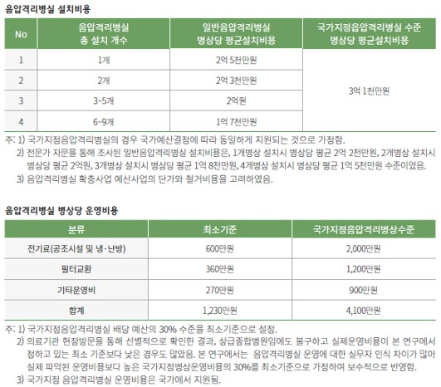
High cost of operating NPU
출처
http://www.docdocdoc.co.kr/news/articleView.html?idxno=1059356
https://www.pharmnews.com/news/articleView.html?idxno=100043

Slide 5
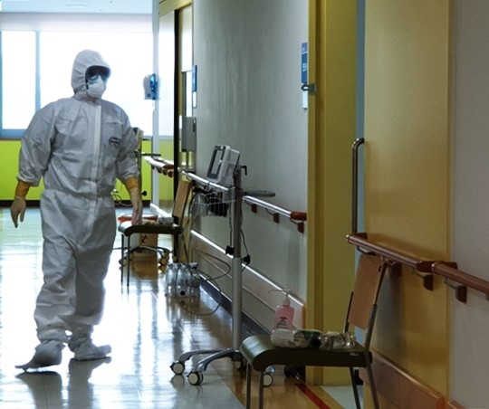
Unavoidable additional cost in traditional hospital for mental treatment

Slide 6
The reasons of Difficulty in immediate response
1. Complex structure of NPU
2. More frequent emergencies than ordinary patients

Slide 7
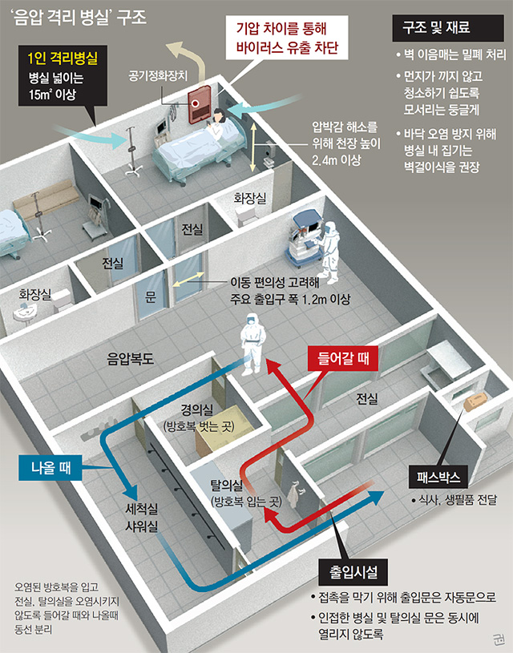
Complex structure of NPU
A total of five doors are required to enter NPR
1) changing room -> front room -> NP hallway
-> front room -> NPR
2) Each door must be closed before the next door can be opened about 10 seconds later.
Lots of equipment and wear time
Remove accessories -> Check that there are holes in protective equipment -> sterilize hands and wear gloves -> Wear full body protective clothing -> Wear outer gloves and overshoes, N95 mask, face shields, apron
10 minutes or more
[출처] - 동아뉴스

Slide 8
More frequent emergencies than ordinary patients
The difficulty for mentally ill people to recognize the seriousness of infectious diseases.
[출처] - 국민일보

Slide 9
The reasons of Deterioration of mental illness
1. Inaccessibility to psychiatric treatment
2. Deterioration of mental illness

Slide 10

Inaccessibility to psychiatric treatment
Prohibition of traditional mental treatments: group therapy & communal dining
출처
https://ps.psychiatryonline.org/doi/10.1176/appi.ps.202000166
https://www.texashealth.org/Newsroom/News-Releases/2020/Behavioral-Health-Unit-Redesigned-for-COVID-19

Slide 11

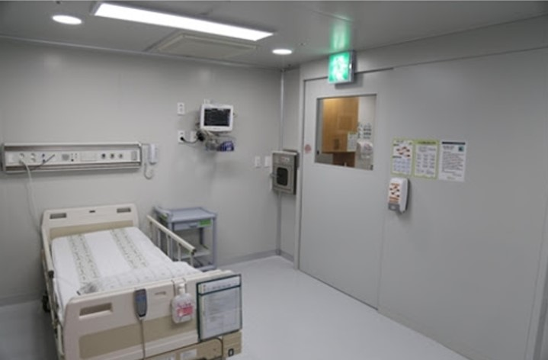
Deterioration of mental illness due to isolation
출처
https://www.ncbi.nlm.nih.gov/pmc/articles/PMC4225959/

Slide 12
Priority
1. Financial problem
2. Difficulty in immediate response
3. Deterioration of mental illness

Slide 13
Thats it. Thank you for watching
Have any questions?

